Slide 1

Deforestation Estimator
Borealis AI
Group – Data Pirates
Mentor – Muhammad Safa
Shayan Mohammadi Kubijari
Rastin Rassoli
Mohanna Shahrad

Slide 2
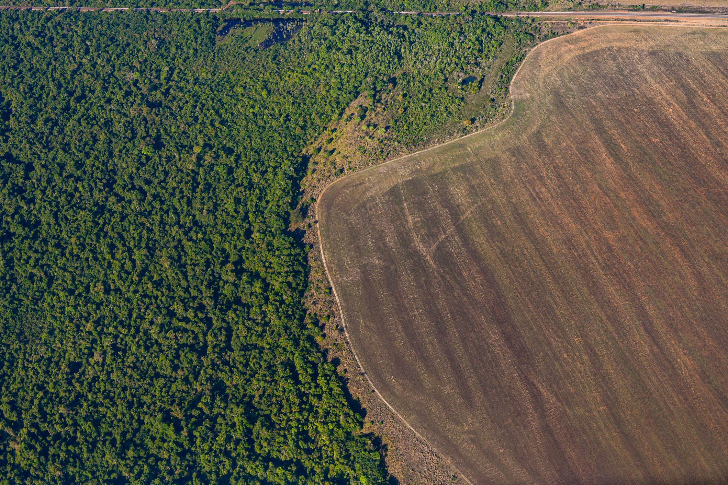
Agenda
Problem Statement
Use Case | How & What
Step 1 – Data & Tools
Step 2 – Model
Step 3 – Boosting & Polishing
Barriers
Insights
Recommendations & Future Actions

Slide 3
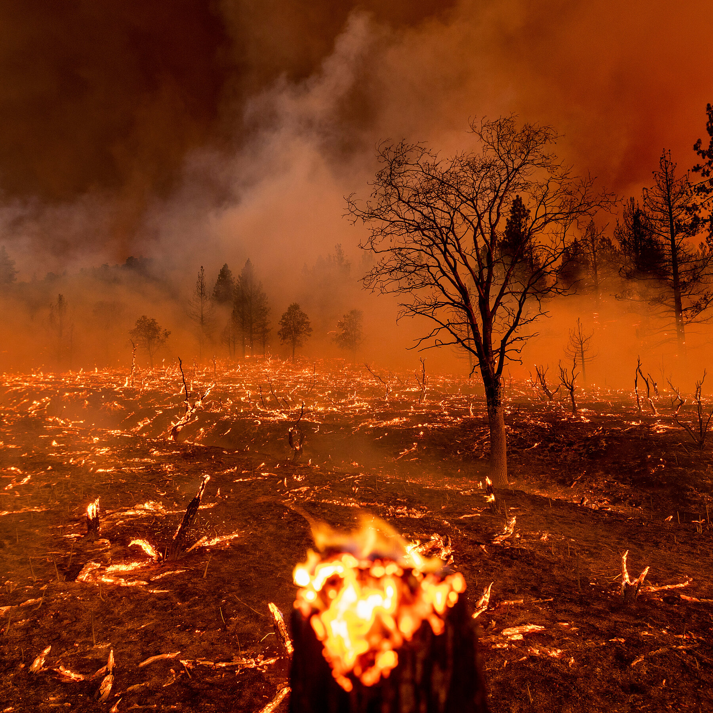
Problem Statement
Largest sources of greenhouse gas emissions from human activities are transportation and fossil fuels
climate scientists have warned there are only a dozen years for stopping global warming and climate change

Slide 4
x
Problem Statement
There are many other questions which are unanswered
How many trees should be planted?
Where should these trees be planted?
Which places are in more danger?
Trees assist the mitigation of climate change
The goal of planting trees should be measurable

Slide 5
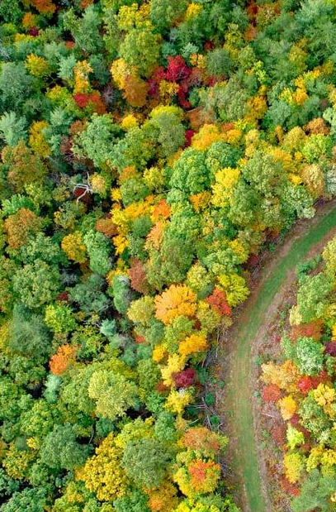
Use Case | How & What
How AI & ML could help?
What is Deforestation Estimator?
Artificial Intelligence (AI) can help us to find the answers
Many Machin learning (ML) algorithms can predict future data using past information
Our ML model can be divided into two sub-models
Deforestation rate
Disforestation distribution

Slide 6
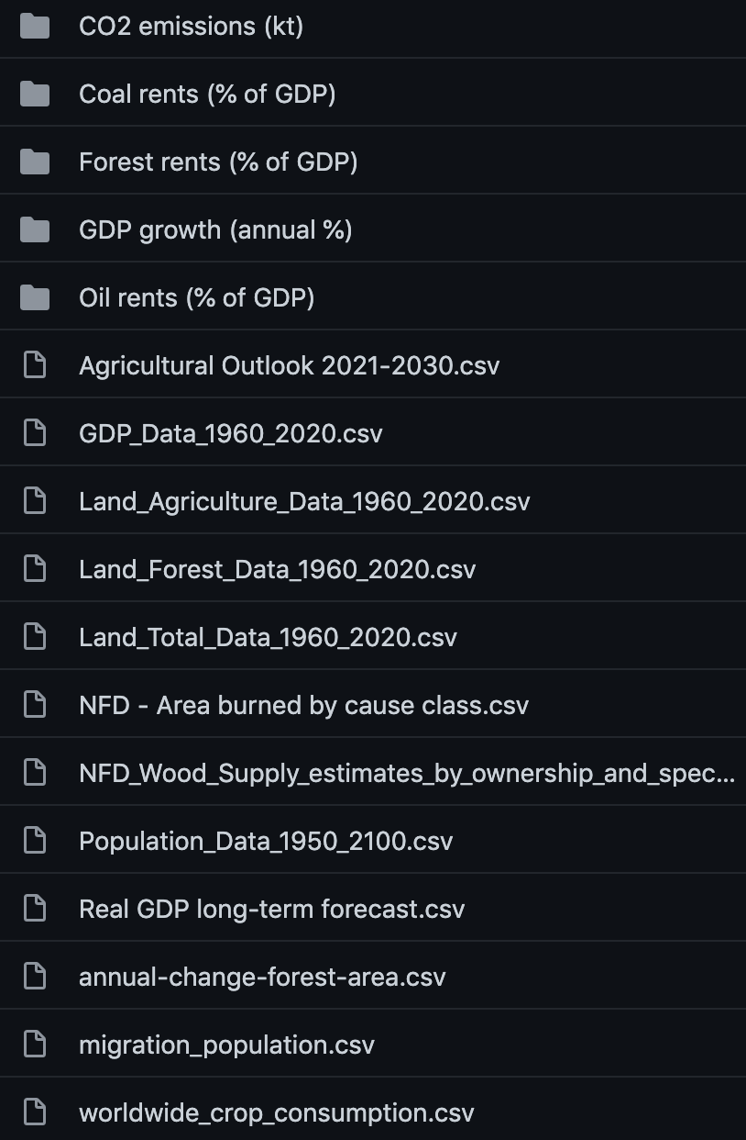
Step 1 – Data Collection
Research
Research on potentially relevant factors impacting deforestation
Sources & Tools
Challenges
Kaggle
GitHub
TheWorldBank Data
OECD Stats
Finding Appropriate Data
Finding Inclusive Data
Finding Accurate Data

Slide 7
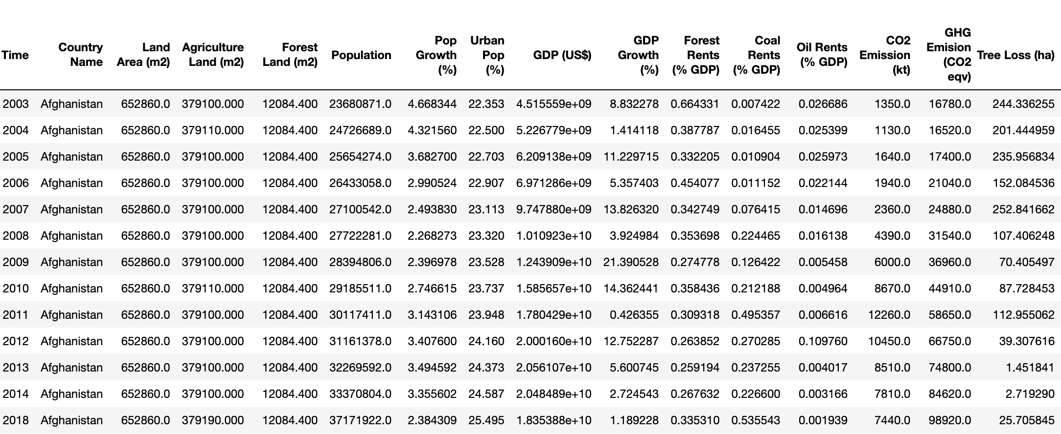
Step 1 – Data Preprocessing
Data Preprocessing
Challenges
Normalization via standard scaling
One-hot Encoding for discrete values
Removing invalid data points
Extremely large gap between our datapoints’ values

Slide 8
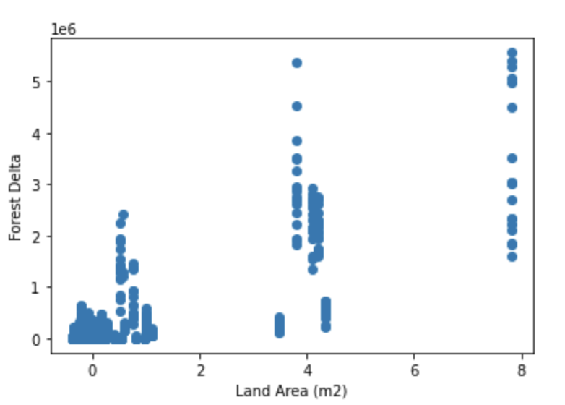
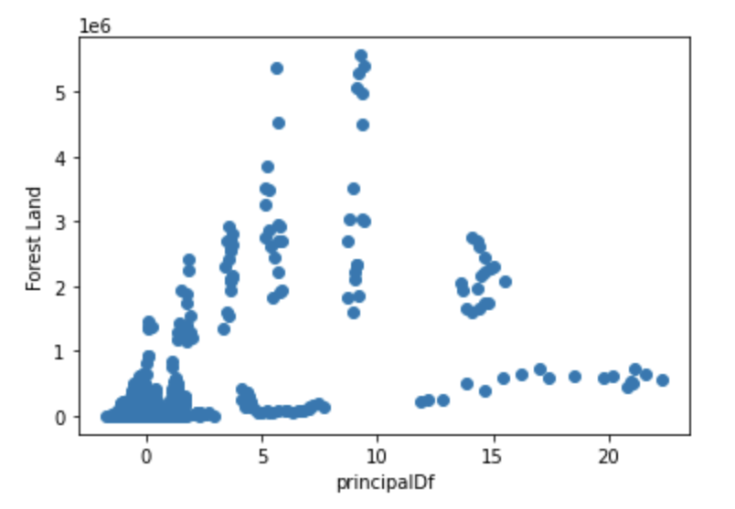
Step 2 – Model Selection
Candidates
Linear Regression
Ensemble Trees
Arima
XGBoost
LightGBM
Selection & Strategies
Feature Analysis
R2 Score
Darts & Prophet

Slide 9

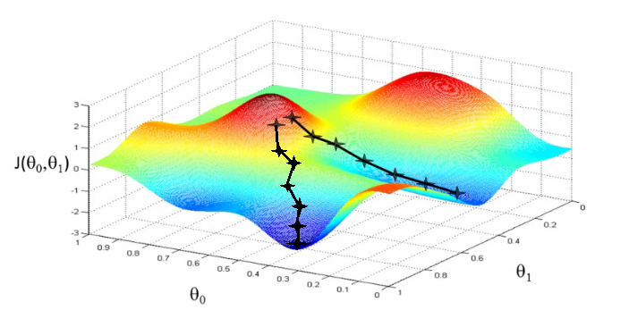
Step 3 – Boosting & Prediction
Boosting
XGBoost: Extreme Gradient Boosting
Specific implementation of the Gradient Boosting method which uses more accurate approximations to find the best tree model by
Prediction
Feature prediction using darts
Deforestation rate prediction from 2020 to 2030

Slide 10
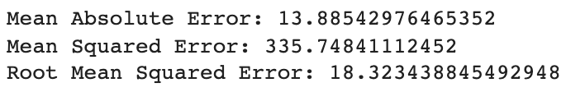
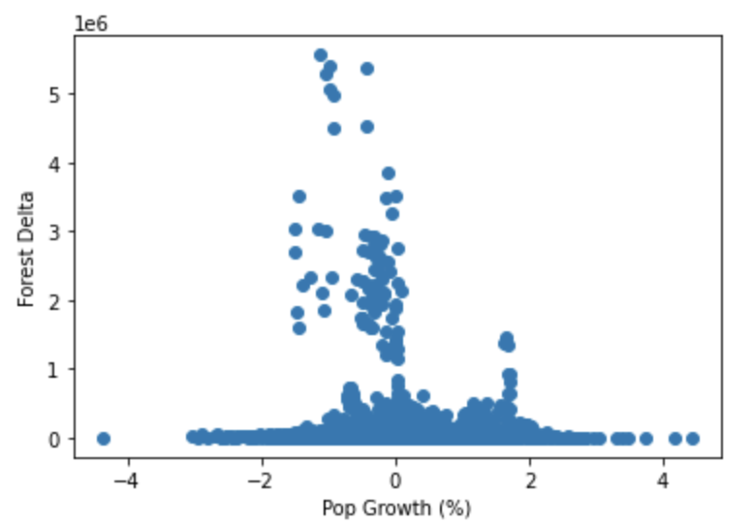
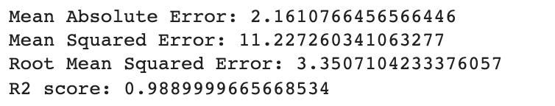
Barriers
Lack of proper and accurate data
Lack of time for expanding our research on the key factors impacting deforestation
Extreme gap between larger and smaller countries data (such as Land, Tree Losses, etc.)

Slide 11
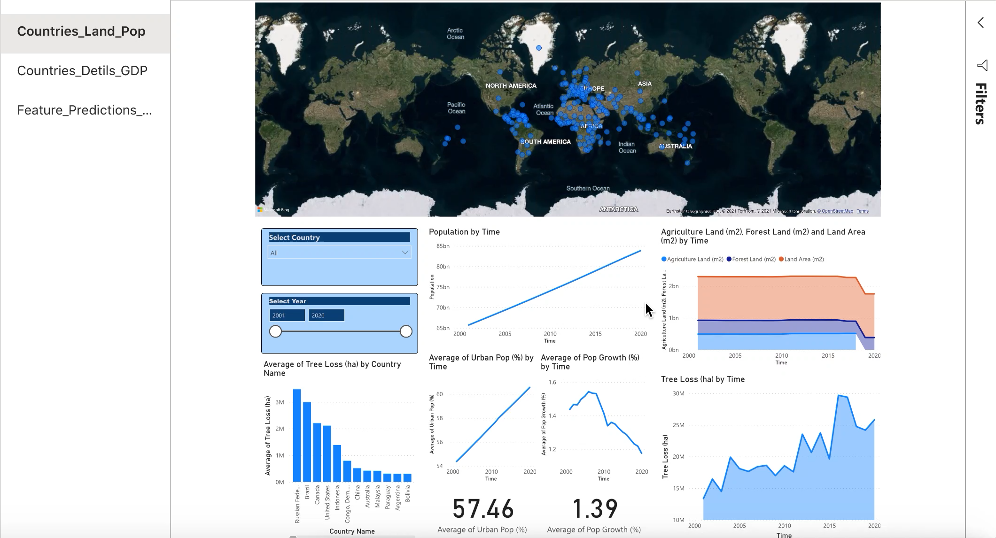
Insights
& Dashboard
Feature Analysis
Forest Land
Land Area
GHG Emission
Agricultural Land
CO2 Emission

Slide 12
Insights
& Dashboard
Dangerous Threats
All of the effective features have a threatening positive trend
China’s CO2 emission rate is as high as the whole North America
Deforestation Rate
All of the effective features have a threatening positive trend
China’s CO2 emission rate is as high as the whole North America

Slide 13

Recommendations & Future Steps
Providing explicit suggestions to countries on how to decrease deforestation rate
Helping organizations with the intention of preventing further deforestation rates
Conducting broader cross-domain research on the factors affecting deforestation

